Slide 1
Fearless Service Design

Slide 2

What we do
We take a human-centered approach to incrementally solve large, complex problems.
Design Research provides insight into the people using and providing government services.
User Experience Design architects how people interact with and perceive government services.
Product Design builds interfaces for people to access government services.
Service Design orchestrates the people, processes and products of government services.
Notes:
Helpdesk improvement
HCD for framing
UX for interfaces
Service design for orchestration

Slide 3
Fearless Design Principles
Human-centered
Focus on the people using and providing government services.
Inclusive
Involve a broad spectrum of people in the design process.
Agile
Improve solutions incrementally over time through iterative feedback.
Purple
Rally around people and value not requirements.

Slide 4

Service Design is the orchestration of people, products and processes.
Notes:
Jordan

Slide 5

Customer Experience Obstacles
Misalignment of customer and organizational value.
Narrow understanding of customer experience.
Lack of buy-in from key decision makers and groups.

Slide 6

Service Design Solutions
Stakeholder mapping defines influencers and impacted groups.
Experience mapping builds shared understanding and empathy.
Co-design generates authentic solutions and commitment.

Slide 7
Stakeholder Mapping

Slide 8
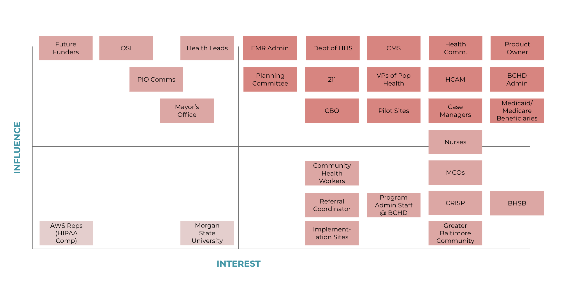
Baltimore City Health Department CHARMcare

Slide 9
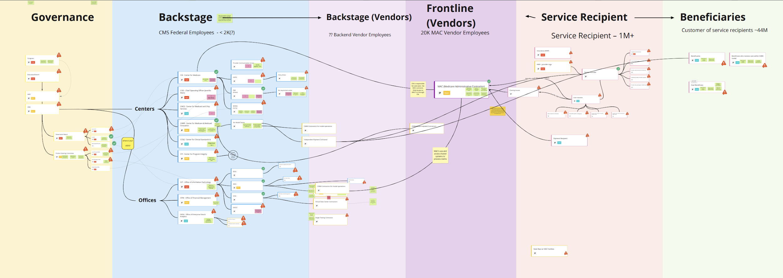
CMS Medicare Payment System Modernization

Slide 10
Experience Mapping

Slide 11
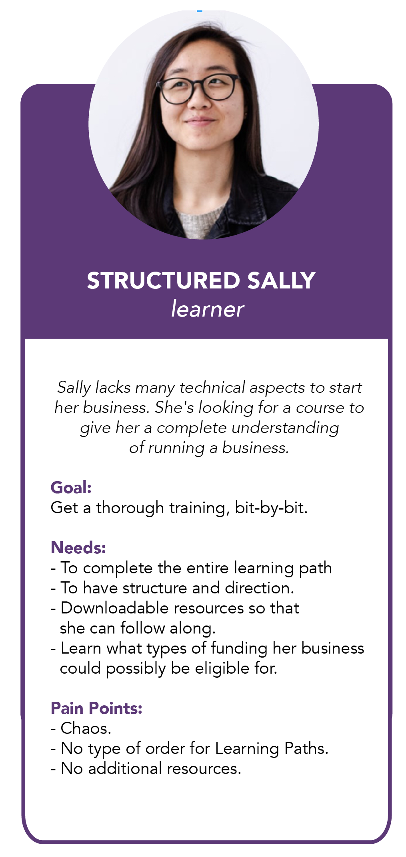
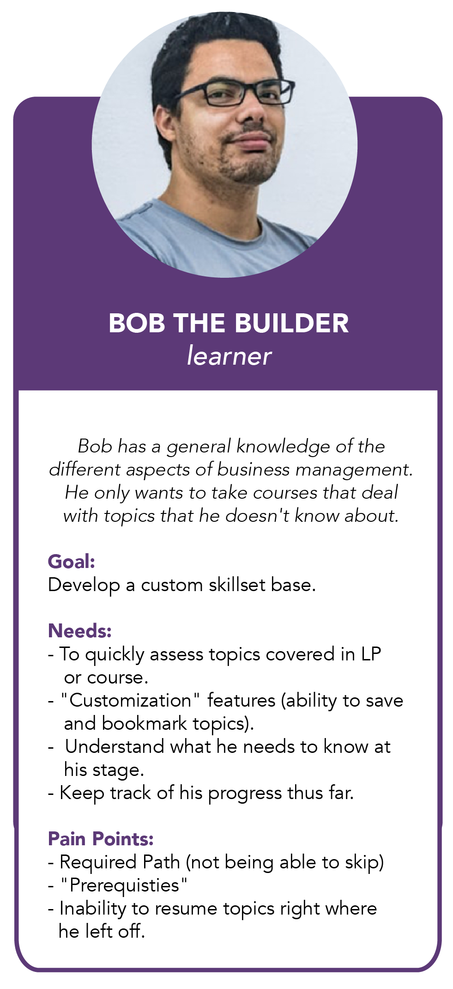
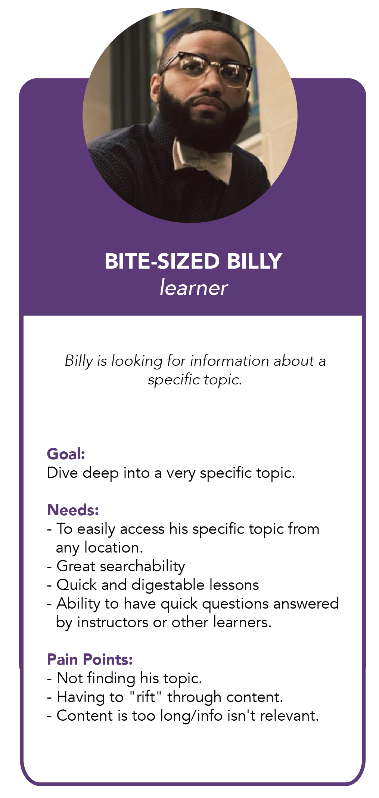
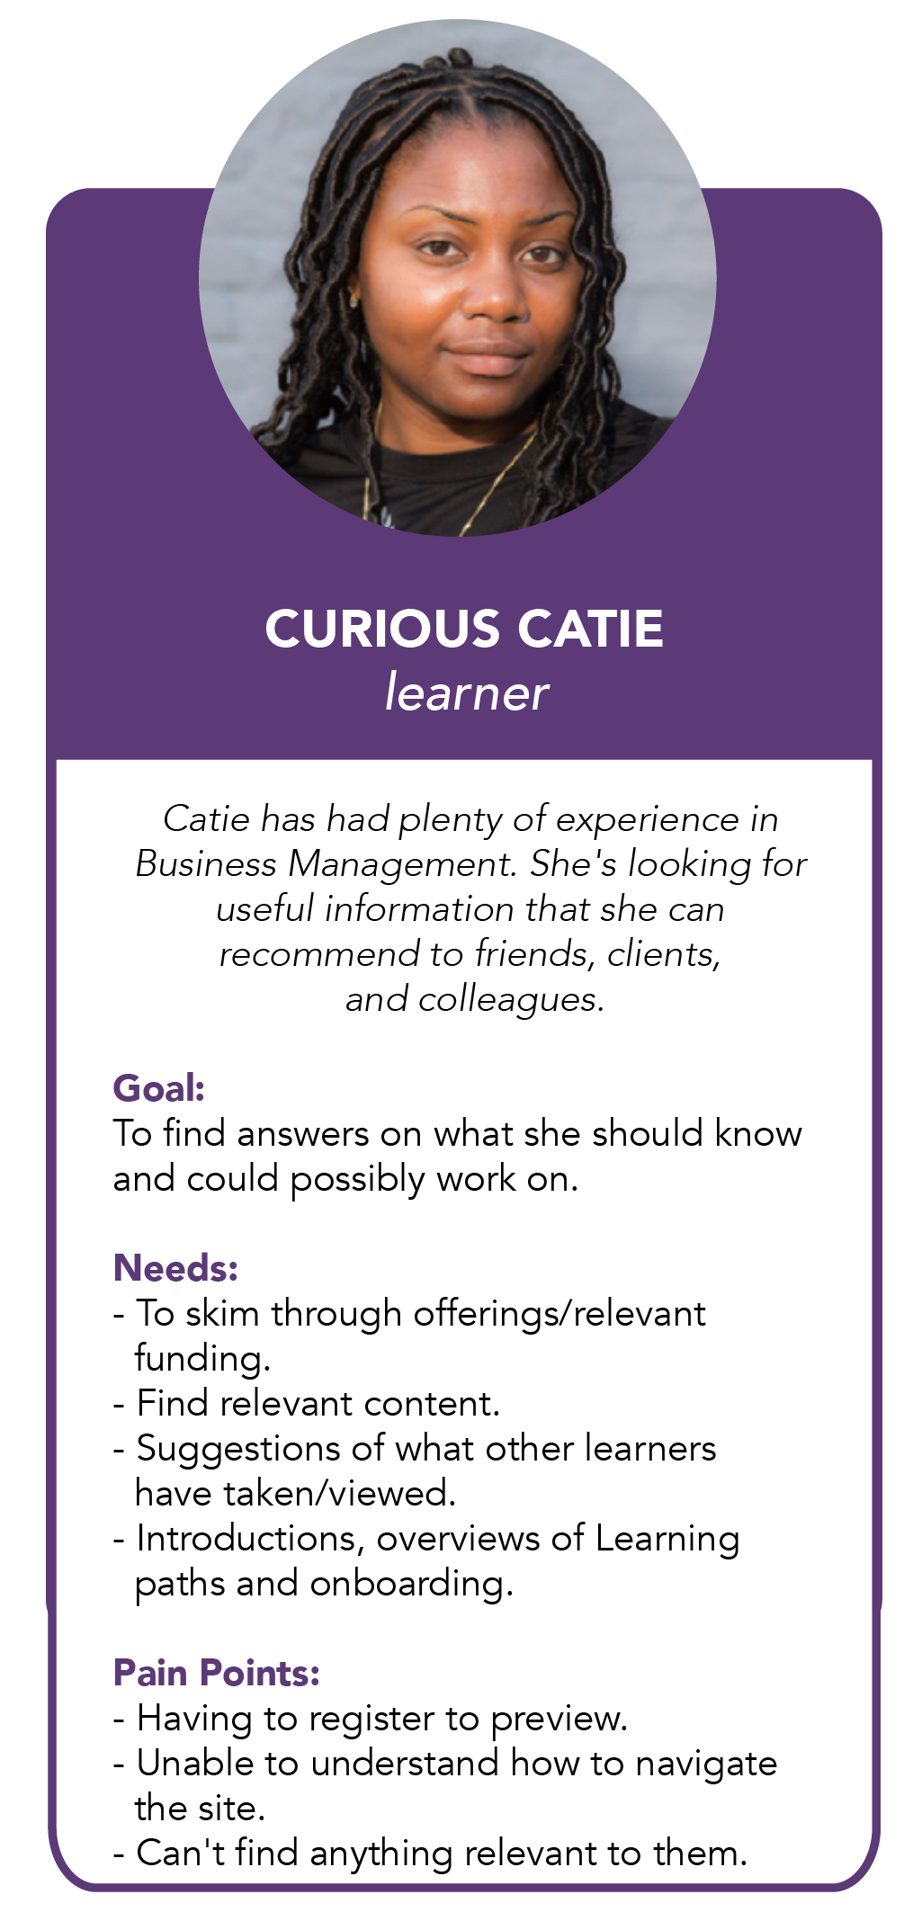
SBA Learning Platform

Slide 12
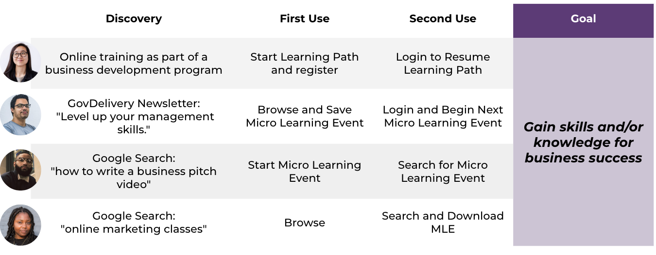
SBA Learning Platform

Slide 13
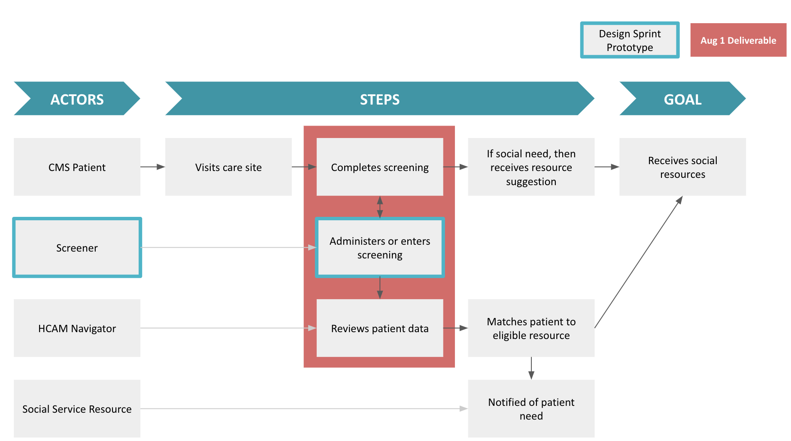
Baltimore City Health Department CHARMcare

Slide 14
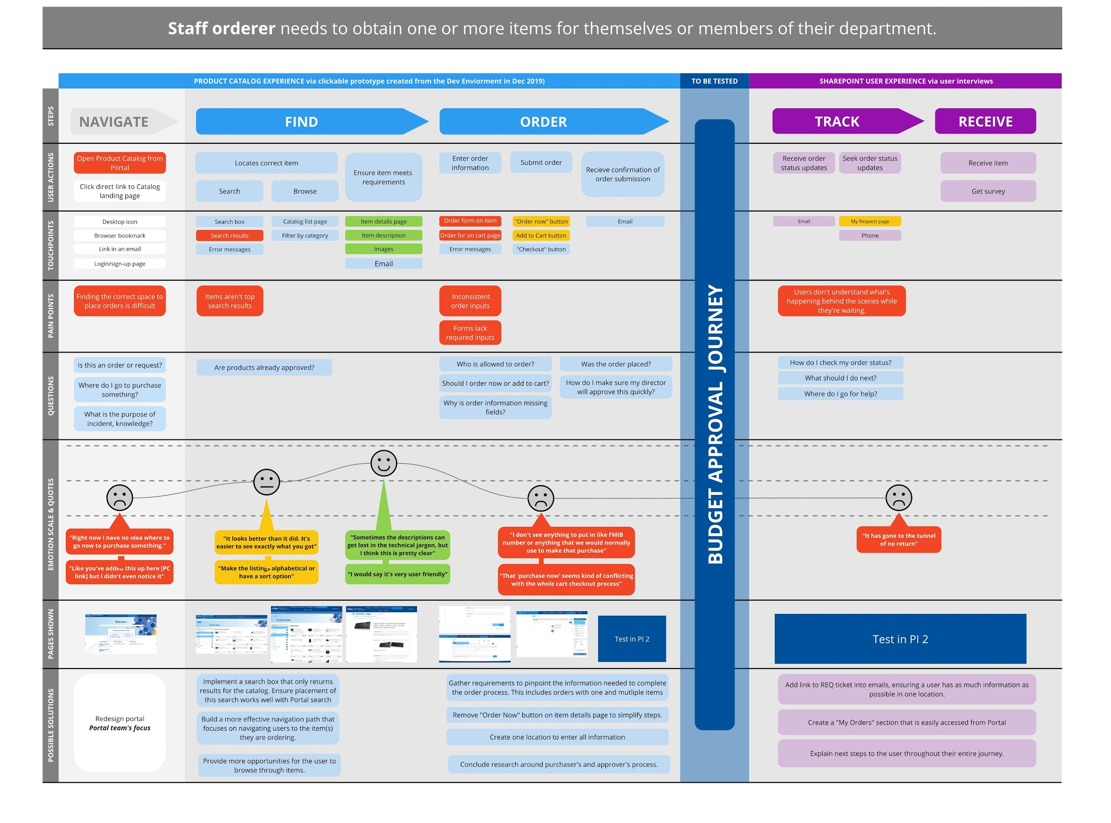
Centers for Medicare and Medicaid Services ShopCMS

Slide 15
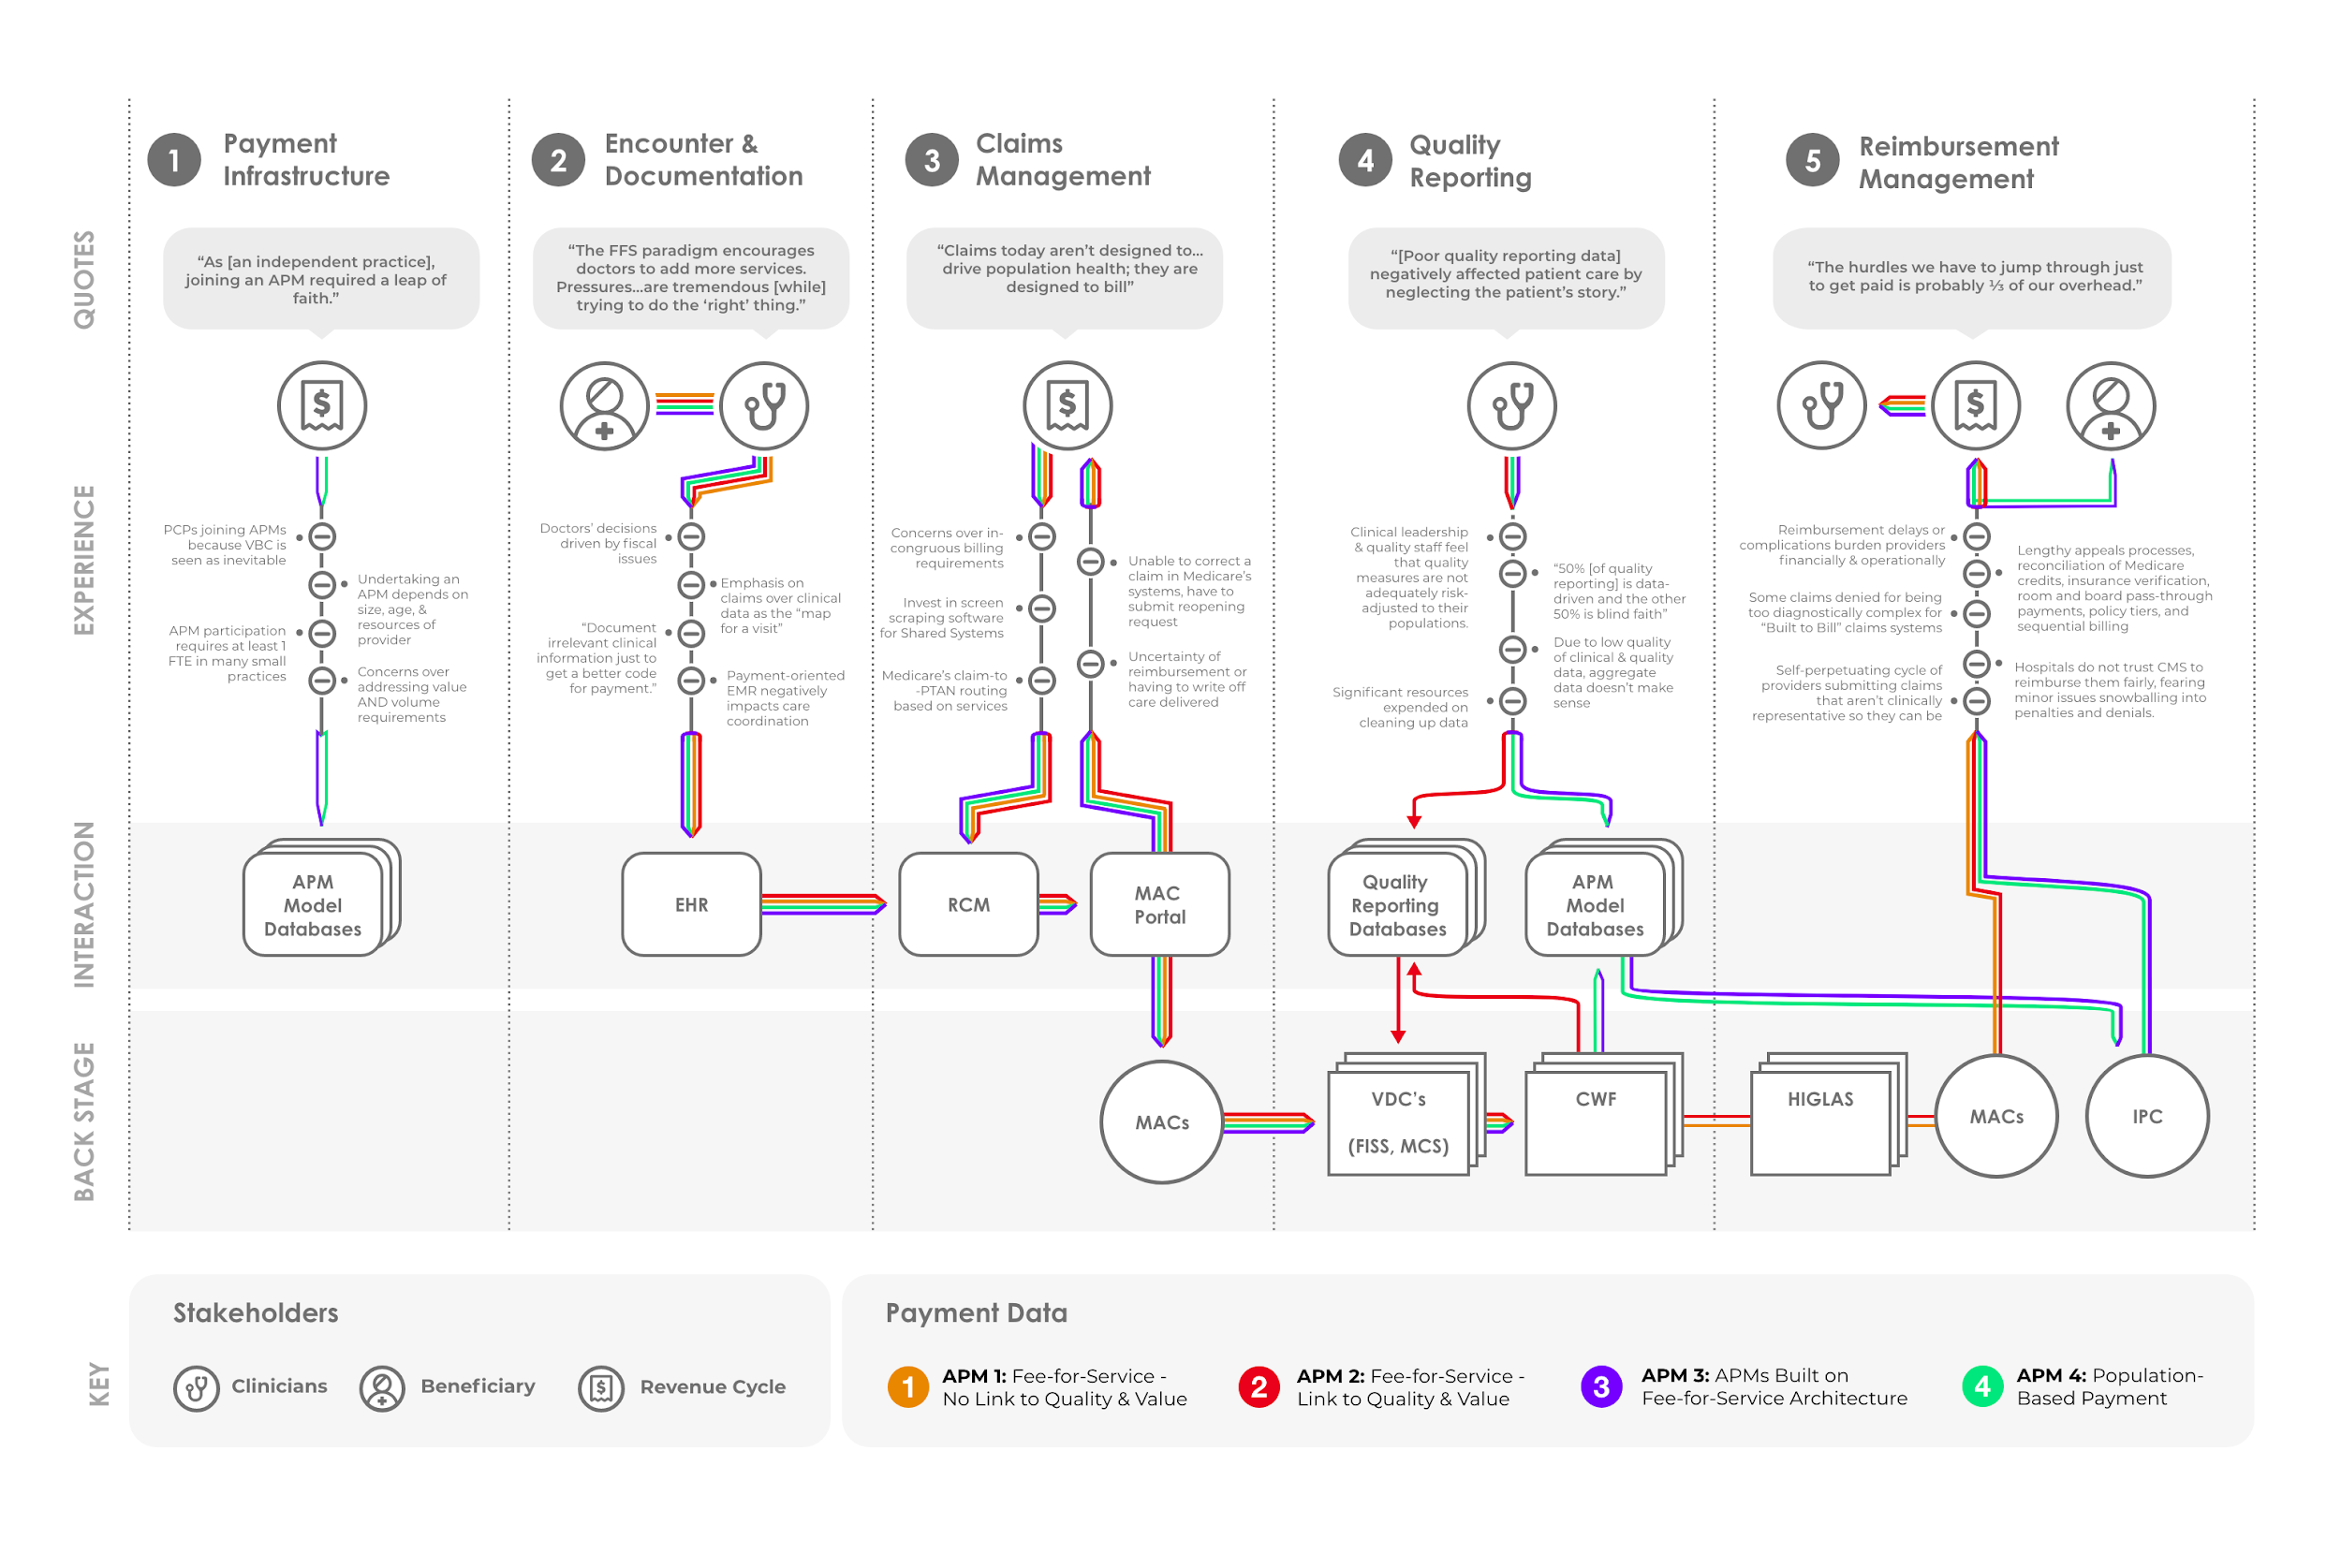
CMS Medicare Payment System Modernization

Slide 16
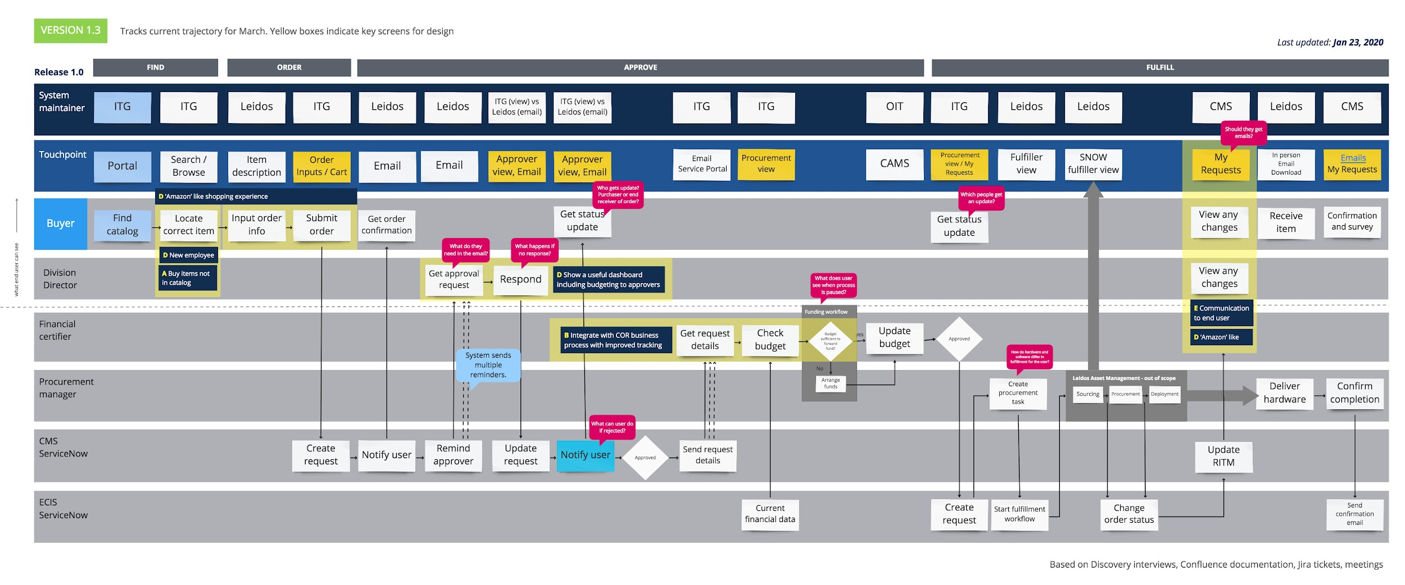
Centers for Medicare and Medicaid Services ShopCMS

Slide 17
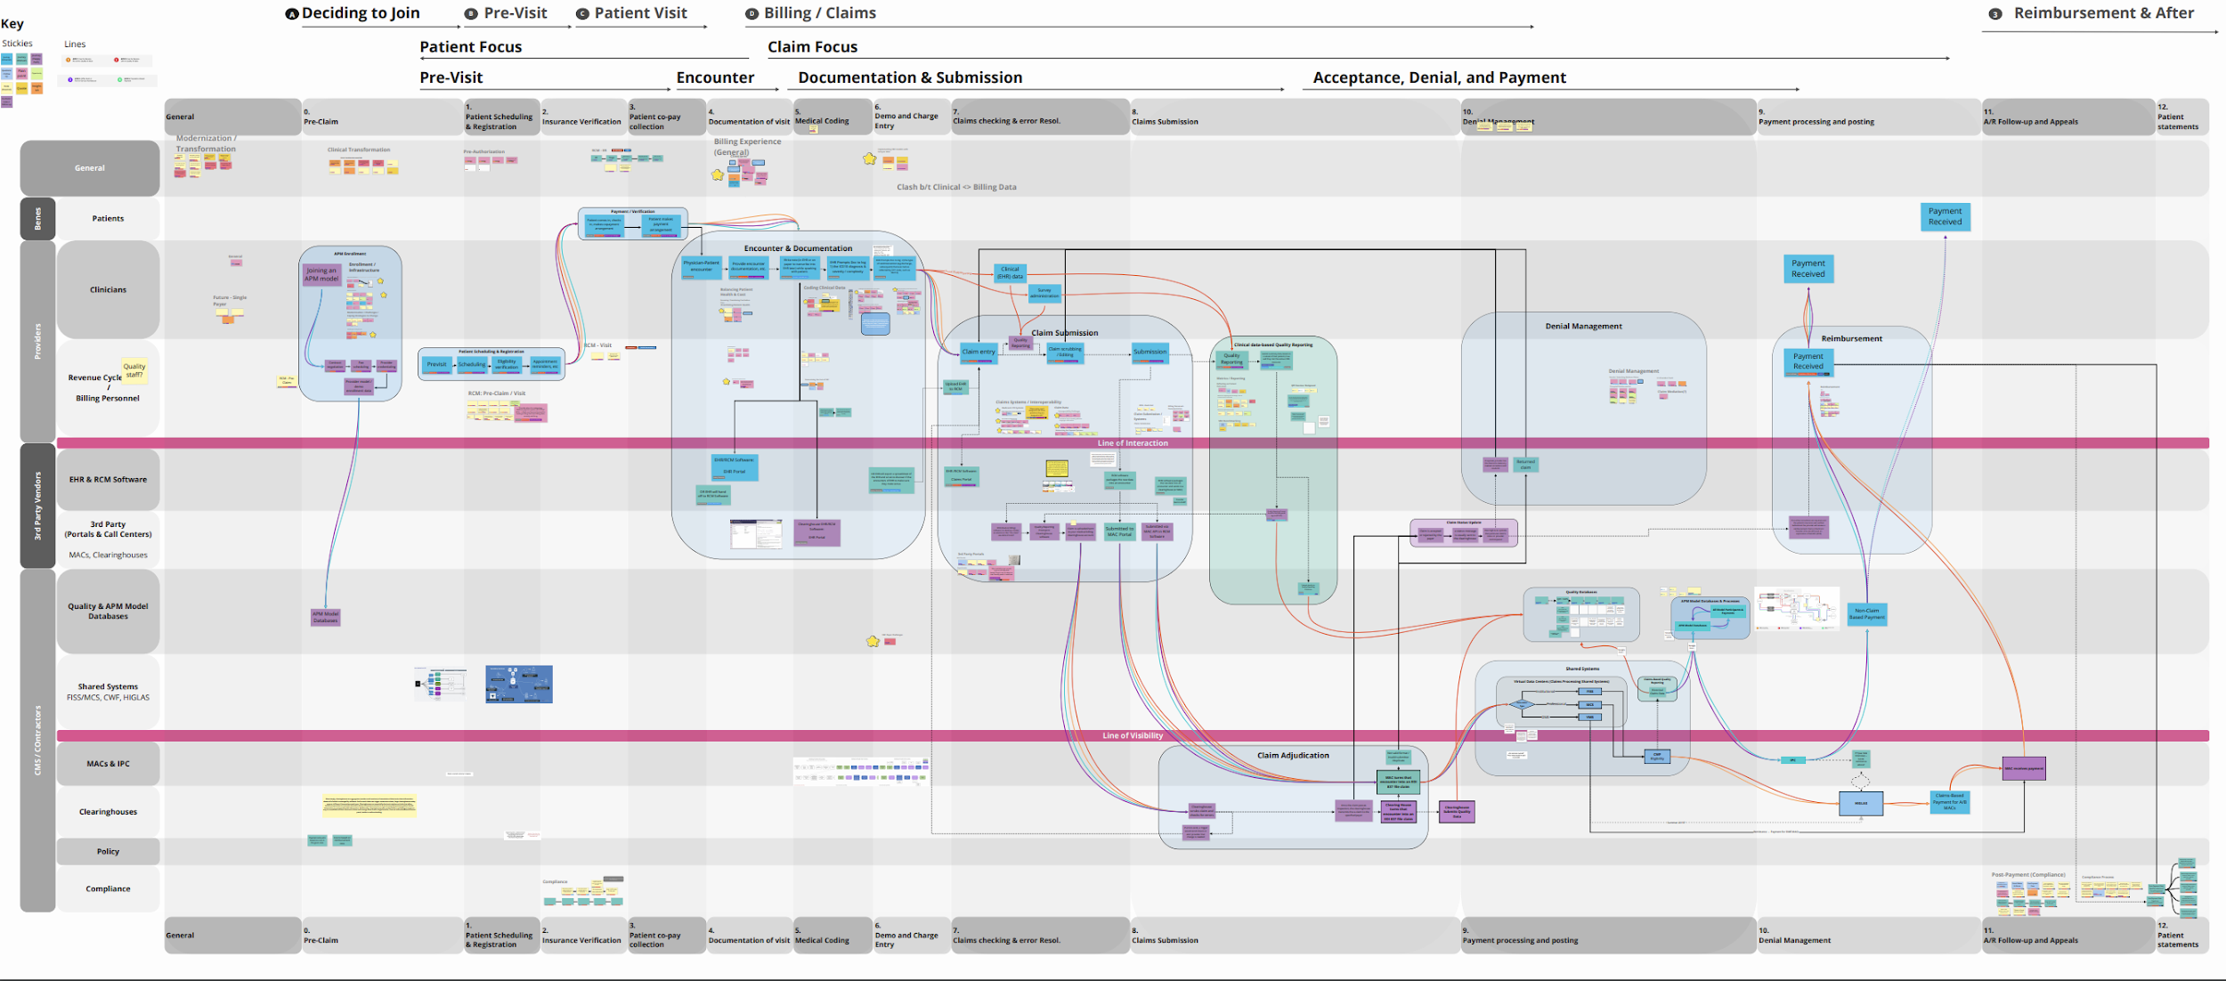
CMS Medicare Payment System Modernization

Slide 18
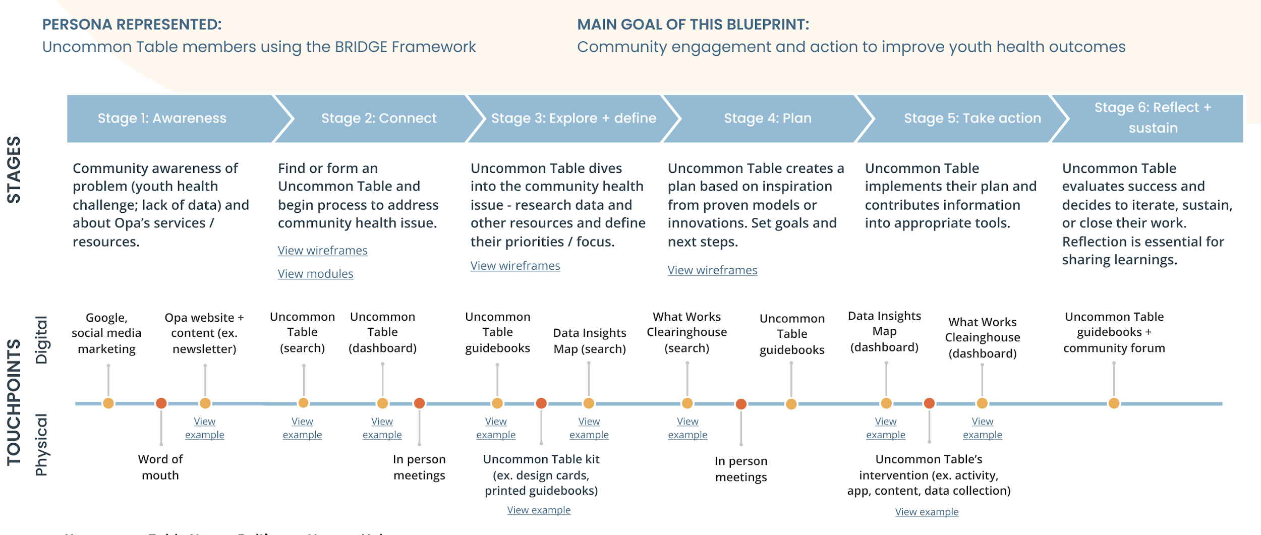
OPA Health Uncommon Table

Slide 19
Co-design

Slide 20
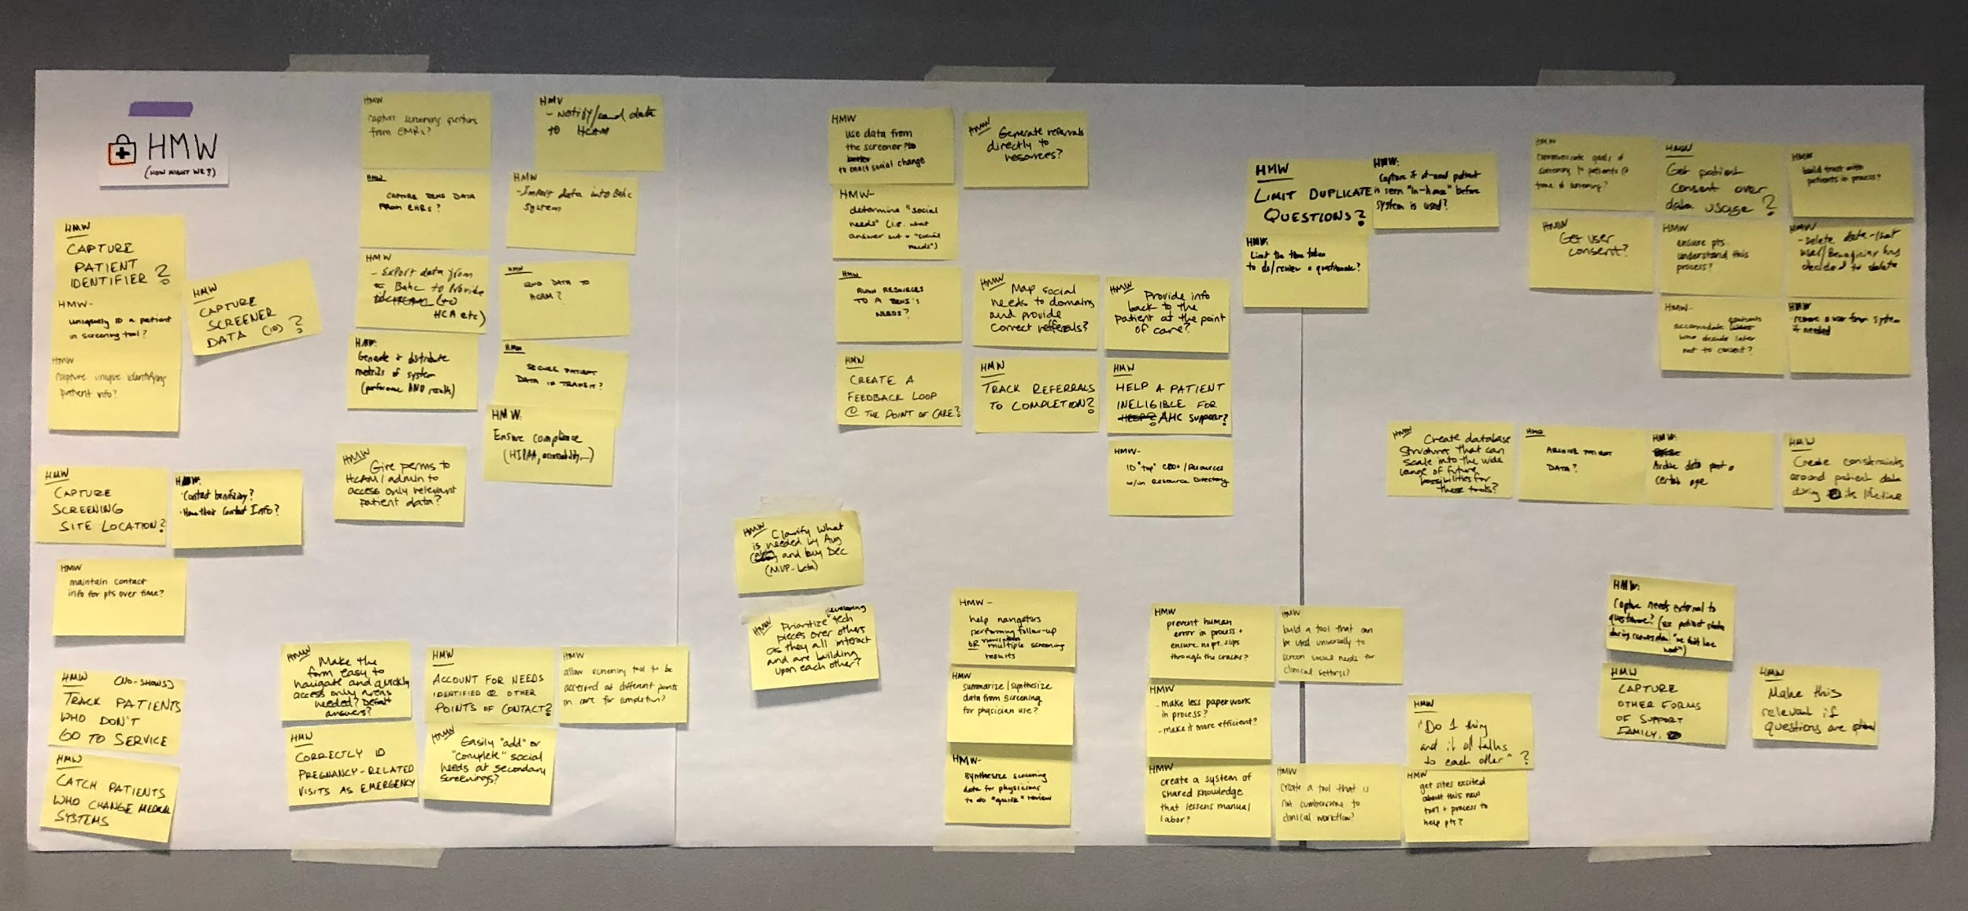
CHARMcare “How Might We?”
Notes:
Kelsey

Slide 21
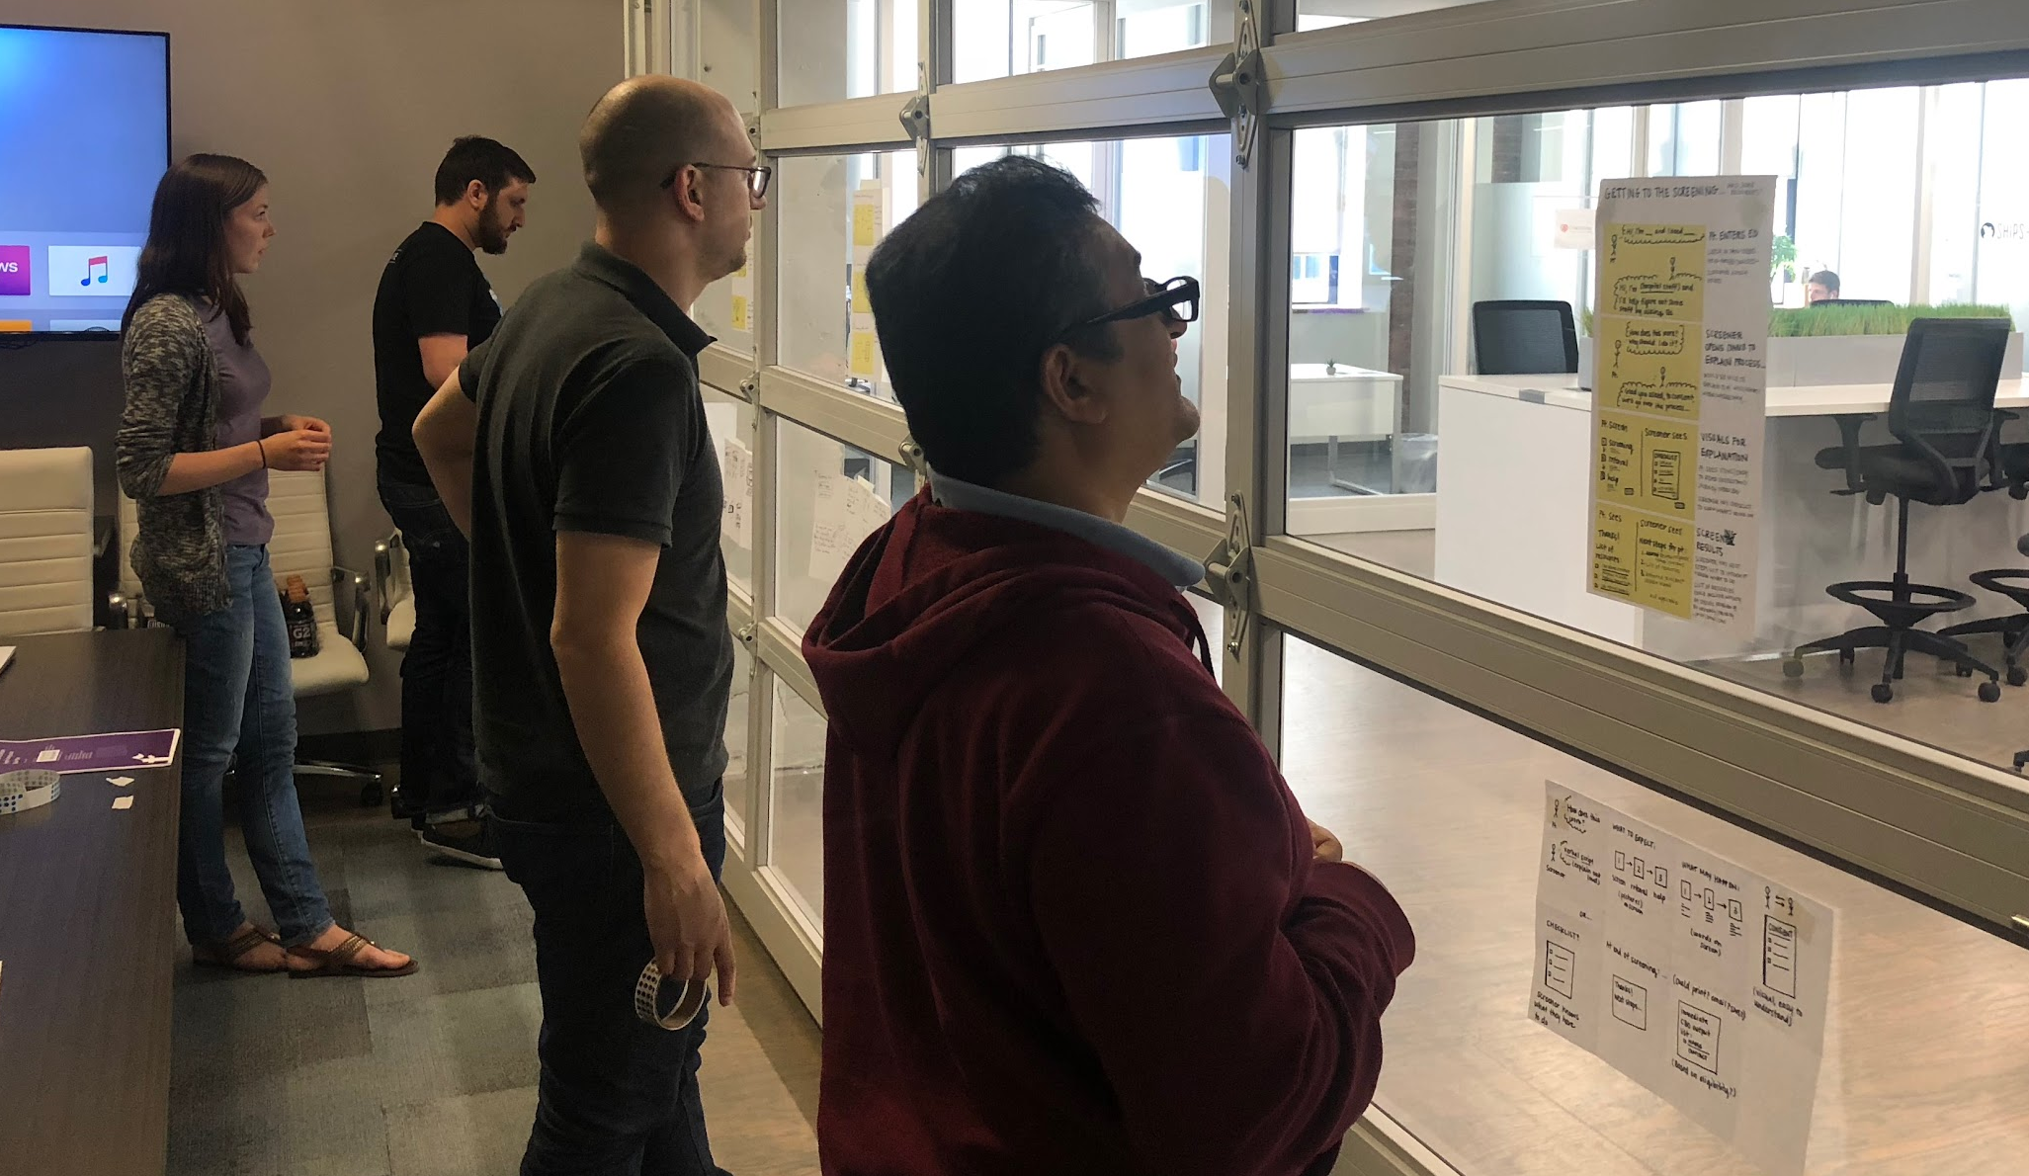
CHARMcare Crazy 8’s and Dot Voting
Notes:
Kelsey

Slide 22
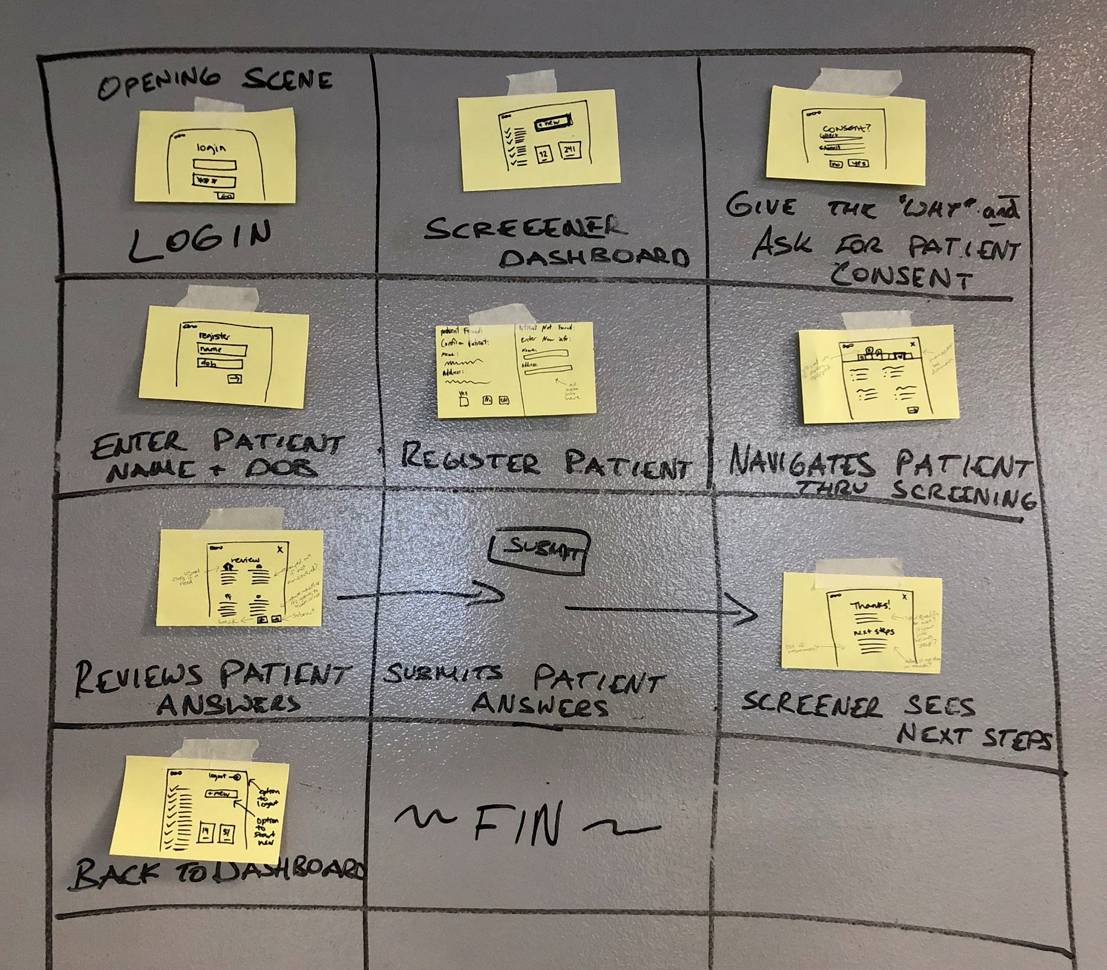
CHARMcare Rapid Prototyping
Notes:
Kelsey

